Slide 1

CapstoneProject-5
(Building Responsive and Interactive Webpages)
Title: Town Trek – Local Guide Web Platform
PRESENTED BY:
MOHANAPRIYA P
Slide no: 1

Slide 2
EXISTING TECHNIQUES:
Project Title: Town Trek – Local Guide Web Platform
Manual: Travelers rely on physical information kiosks, printed guidebooks, brochure pamphlets, or static paper maps provided by local tourism boards.
Online Maps: Users search for places using general-purpose tools like Google, TripAdvisor, or social media platforms (Instagram)
Informal Local Communication : Tourists rely on word-of-mouth recommendations from hotel staff, taxi drivers, or informal forums.
Slide no: 2

Slide 3
SOLUTION:
Project Title: Town Trek – Local Guide Web Platform
Centralized Local Guide Hub: Connects travellers directly with verified local guides and curated spots through a single, easy-to-use web platform.
Interactive & Dynamic Exploration: Offers real-time map navigation, smart filters (by interest),and customized itinerary planning.
Direct Booking & Communication: Enables users to seamlessly book local guides, schedule tours, and contact hosts directly without switching apps.
Slide no: 3

Slide 4
REQUIREMENT
Project Title: Town Trek – Local Guide Web Platform
Semantic HTML5
CSS and Bootstrap Grid System
JavaScript DOM Manipulation
Axios for HTTP Requests
Async/Await for Asynchronous Code
Json-server for Local Mock REST API
Form Validation with Alert Messages
Client-Side Filtering
Responsive Web Design
Accessible UI/UX
Slide no: 4

Slide 5
File Structure
Project Title: Town Trek – Local Guide Web Platform
fffyTown-trek-basic/
Iiiiiiiindex.html
db.json
App.js
Slide no: 5

Slide 6
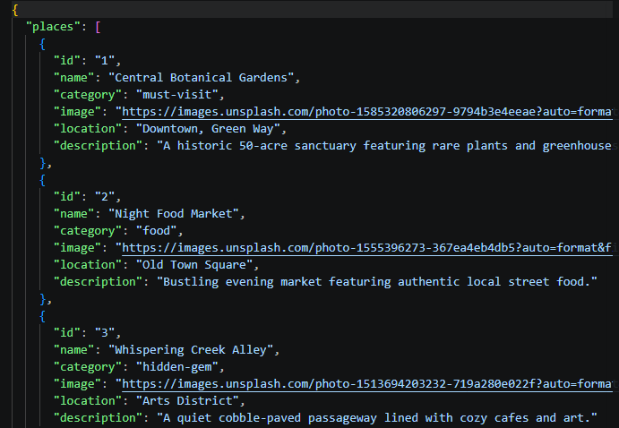
Db.json (Database file)
Project Title: Town Trek – Local Guide Web Platform
This file stores JSON data. json-server reads this file and turns it into a live API endpoint (http://localhost:3000/places).
Slide no: 6

Slide 7
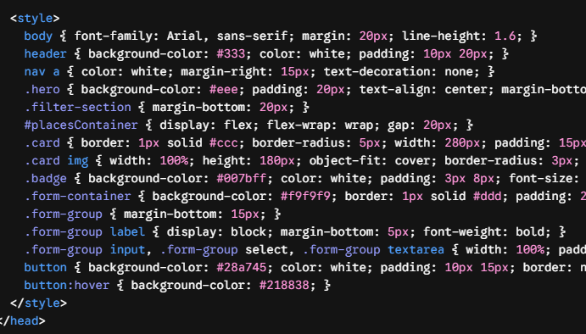
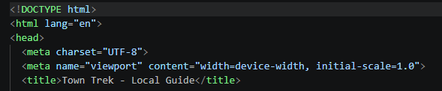
Index.html (Webpage Structure)
Project Title: Town Trek – Local Guide Web Platform
This file builds the page layout: Header, Hero banner, Filter dropdown, Card list container, and Form fields.
Head & CSS section Basic CSS layout
Slide no: 7

Slide 8
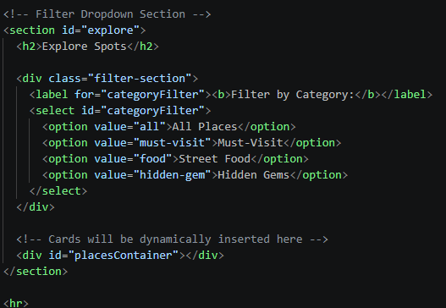
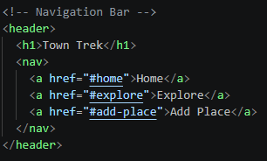
Body Content Section
Project Title: Town Trek – Local Guide Web Platform
1. header>: Displays top dark bar containing website name (<h1>) and three anchor links (<nav>)
2. <section id="home">: Welcome box with heading and introduction text.
<select id="categoryFilter">: Dropdown menu where users pick categories. JavaScript monitors this element ID to filter items.
<div id="placesContainer"></div>: Key element! Starts empty. JavaScript inserts card items inside this div dynamically.
Slide no: 8

Slide 9
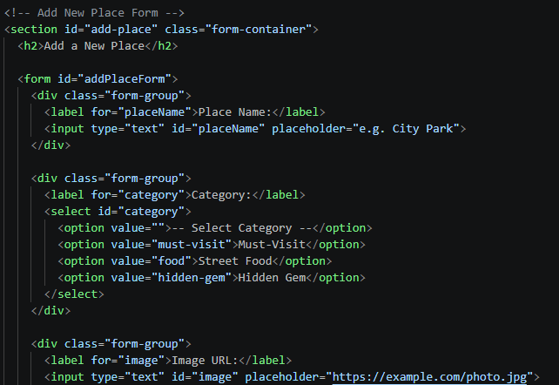
Project Title: Town Trek – Local Guide Web Platform
<form id="addPlaceForm">: Collects user input data.
Each input has a unique id attribute (placeName, category, image, location, description) so JavaScript can extract its text value.
Slide no: 9

Slide 10
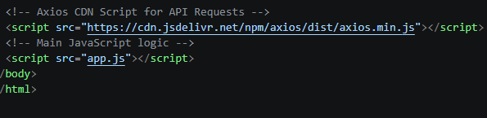
Project Title: Town Trek – Local Guide Web Platform
Axios Script Tag: Loads the external Axios library so we can make HTTP requests (axios.get, axios.post).
app.js Script Tag: Loads our custom JavaScript logic. Must be placed at the bottom so HTML elements exist before JavaScript targets them.
Slide no: 10

Slide 11
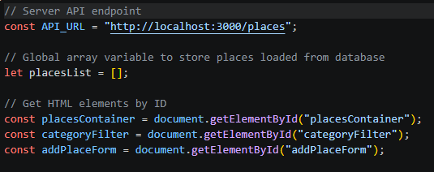
JavaScript Execution & logic
Project Title: Town Trek – Local Guide Web Platform
Global setup & variable Bindings
const API_URL: Stores the backend database address.
let placesList = []: Global empty array used to hold places fetched from json-server.
document.getElementById(...): Grabs target HTML elements from index.html and saves them into memory variables for interaction.
Slide no: 11

Slide 12
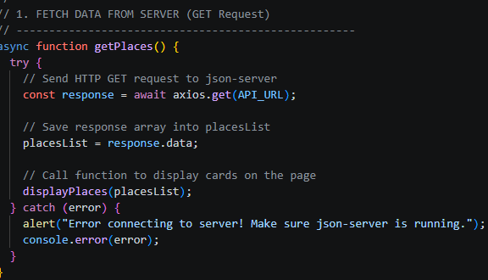
JavaScript Execution & logic
Project Title: Town Trek – Local Guide Web Platform
Function 1: getPlaces() — Fetches Data from Server
What it does: Sends an asynchronous GET request to json-server to fetch saved place records.
Slide no: 12

Slide 13
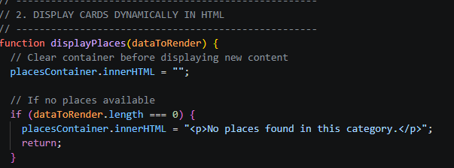
JavaScript Execution & logic
Project Title: Town Trek – Local Guide Web Platform
Function 2: displayPlaces(dataToRender) — Renders Cards in HTML
What it does: Accepts an array of place objects, builds HTML card elements using a forEach loop, and inserts them into #placesContainer.
Slide no: 13

Slide 14
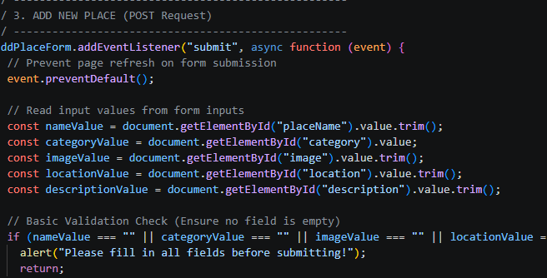
JavaScript Execution & logic
Project Title: Town Trek – Local Guide Web Platform
Function 3: Form Event Listener — Adds a New Place (POST)
What it does: Listens for form submissions, validates that inputs are not empty, constructs a new data object, sends an HTTP POST request to json-server, and refreshes the card display..
Slide no: 14

Slide 15
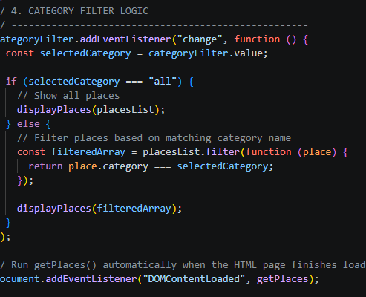
JavaScript Execution & logic
Project Title: Town Trek – Local Guide Web Platform
Function 4: Filter Listener & Initializer
What it does: Filters displayed places by selected category and boots up the app when the page finishes loading.
Slide no: 15

Slide 16
WHAT MORE CAN BE ADDED IN FUTURE:
Project Title: Town Trek – Local Guide Web Platform
Database Integration: Replace json-server with a persistent database like MongoDB or PostgreSQL to handle real production data.
Backend API Development: Upgrade the mock REST API to a fully built backend server using Node.js/Express or Java Spring Boot.
AI Travel Assistant: Integrate an AI chatbot (e.g., OpenAI API) to suggest personalized city itineraries based on user budget and interests.
Slide no: 16

Slide 17
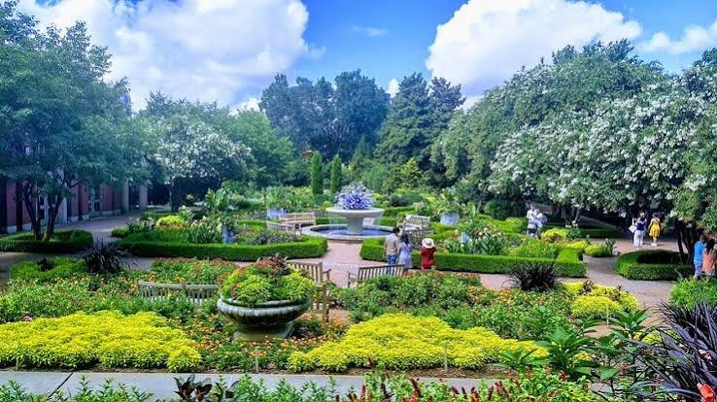


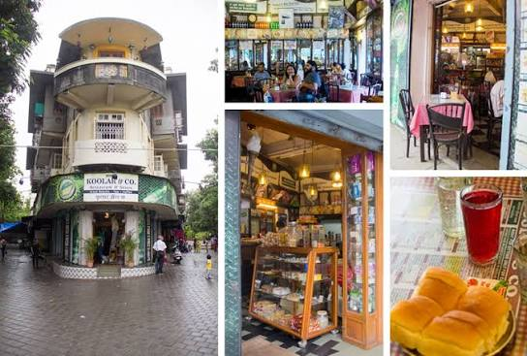

Project Title: Town Trek – Local Guide Web Platform
Slide no: 17

Slide 18

Slide no: 18

